Slide 1

TAKENMIND GLOBAL DATA ANALYTICS INTERNSHIP PROJECT(PROOF-OF-CONCEPT)
EMPLOYEE ATTRITION CONTROL
BY EKANEM ELIZABETH

Slide 2

INTRODUCTION
What is employee attrition?
It is the reduction in staff or employee over a period of time due to voluntarily or by being laid-off by the company.
Employee attrition rate is usually calculated as total number of employees lost by the total number of employees previously x 100.

Slide 3
PROBLEM STATEMENT
The data is for company X which is trying to control attrition. There are two sets of data: "Existing employees" and "Employees who have left".The following attributes affect attrition:
-Satisfaction Level
-Last evaluation
-Number of projects
-Average monthly hours
-Time spent at the company
-Whether they had a work accident
-Whether they have had a promotion in the last 5 years
-Department
-Salary
-Whether the employee has left

Slide 4
PROJECT OBJECTIVE
The objective of this project is to determine:
What type of employees are leaving?
Which employees are prone to leave next?
By understanding what type of employees are prone to leave the company, we can predict the future employee who would tend to leave the company.

Slide 5
DATA ANALYSIS METHODOLOGY
Analysis and comparison of UniVariants and Multi-Variants
Observations
Conclusion

Slide 6
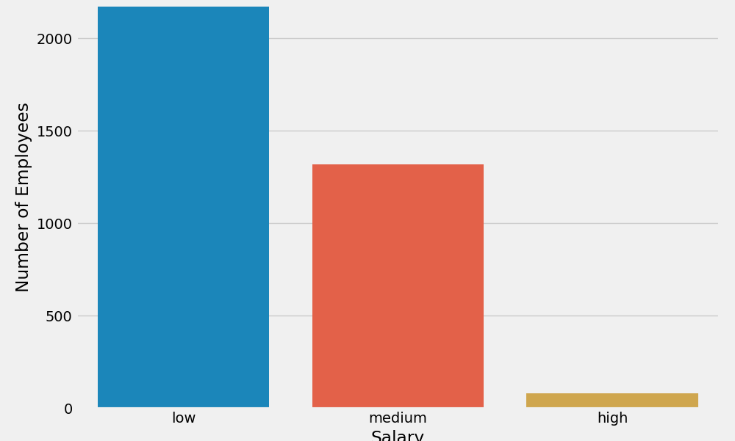
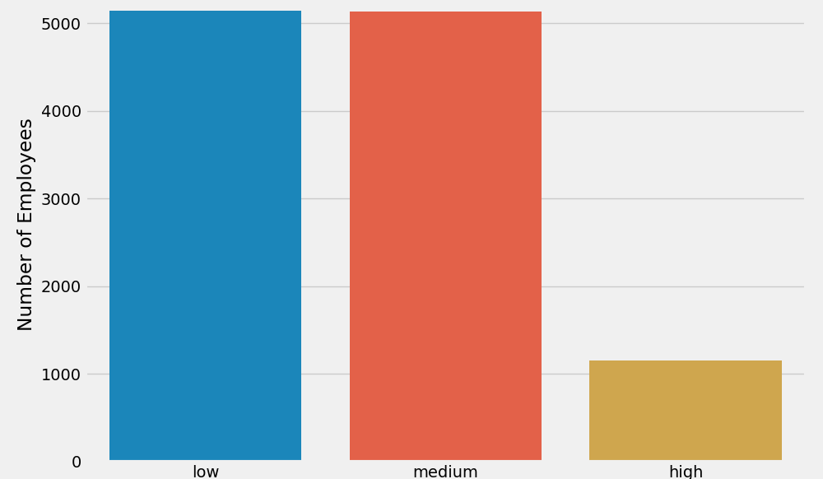
UNIVARIANT ANALYSIS
PLOT 1: DISTRIBUTION OF SALARIES BETWEEN EMPLOYEES WHO LEFT AND EXISTING EMPLOYEES.

Slide 7
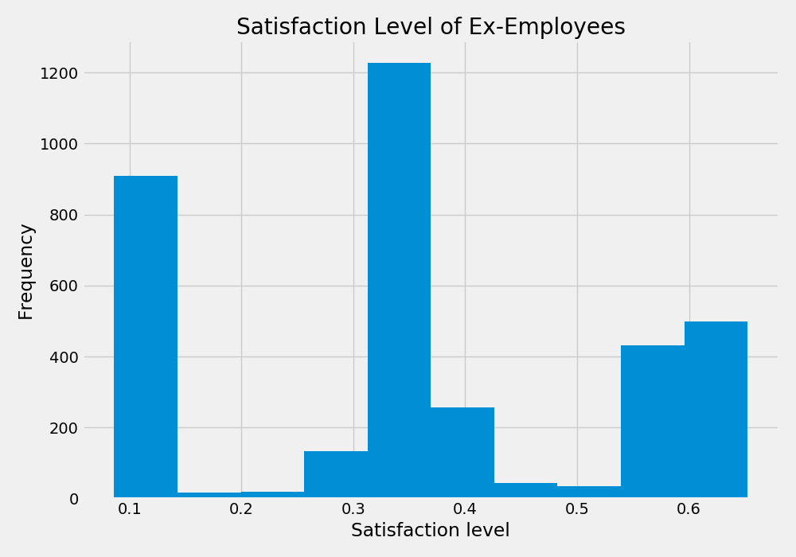
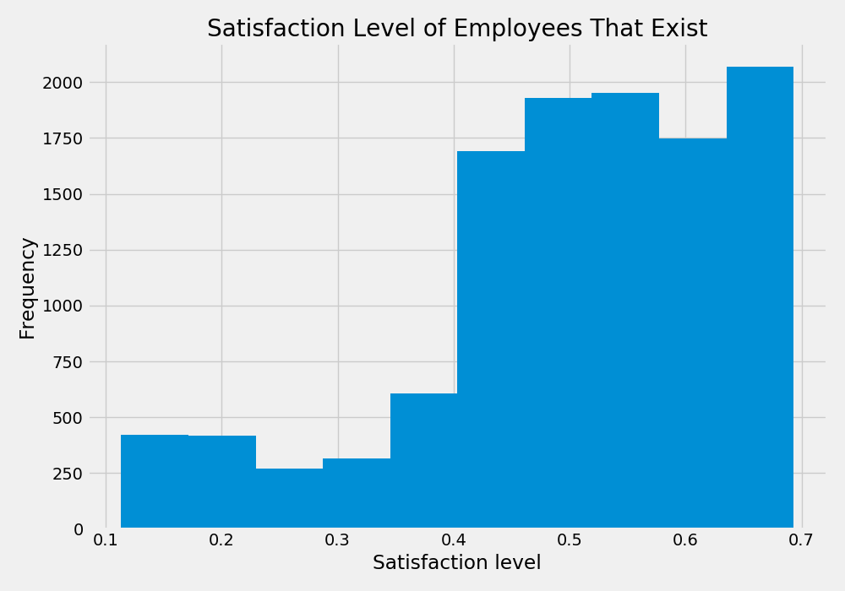
UNIVARIANT ANALYSIS
PLOT 2: COMPARISON OF SATISFACTION LEVELS BETWEEN EMPLOYEES WHO LEFT AND EXISTING EMPLOYEES.

Slide 8
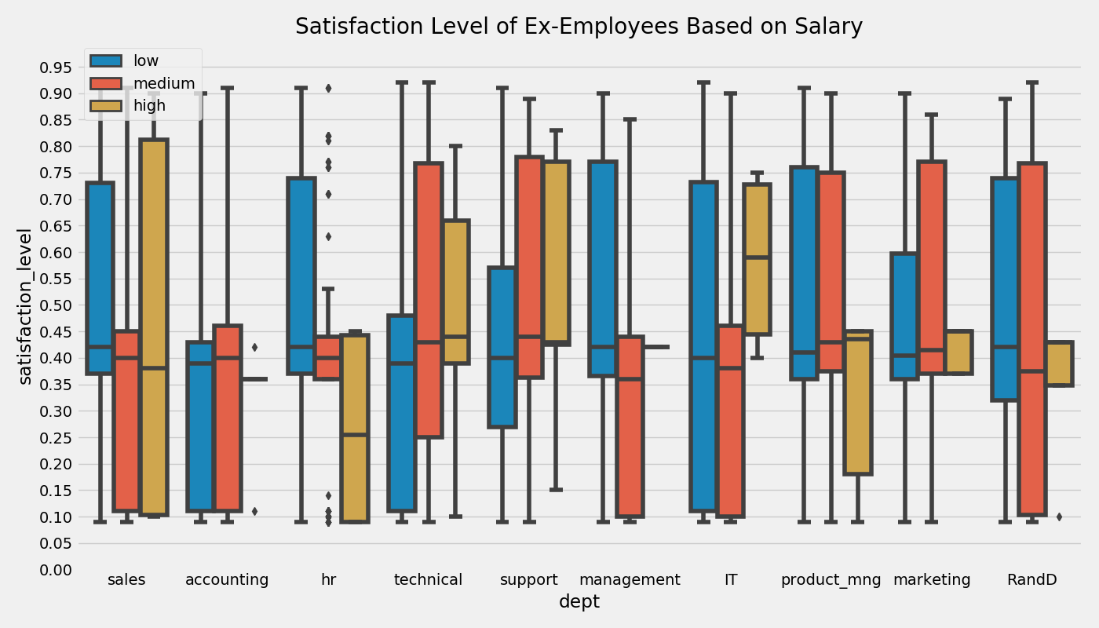
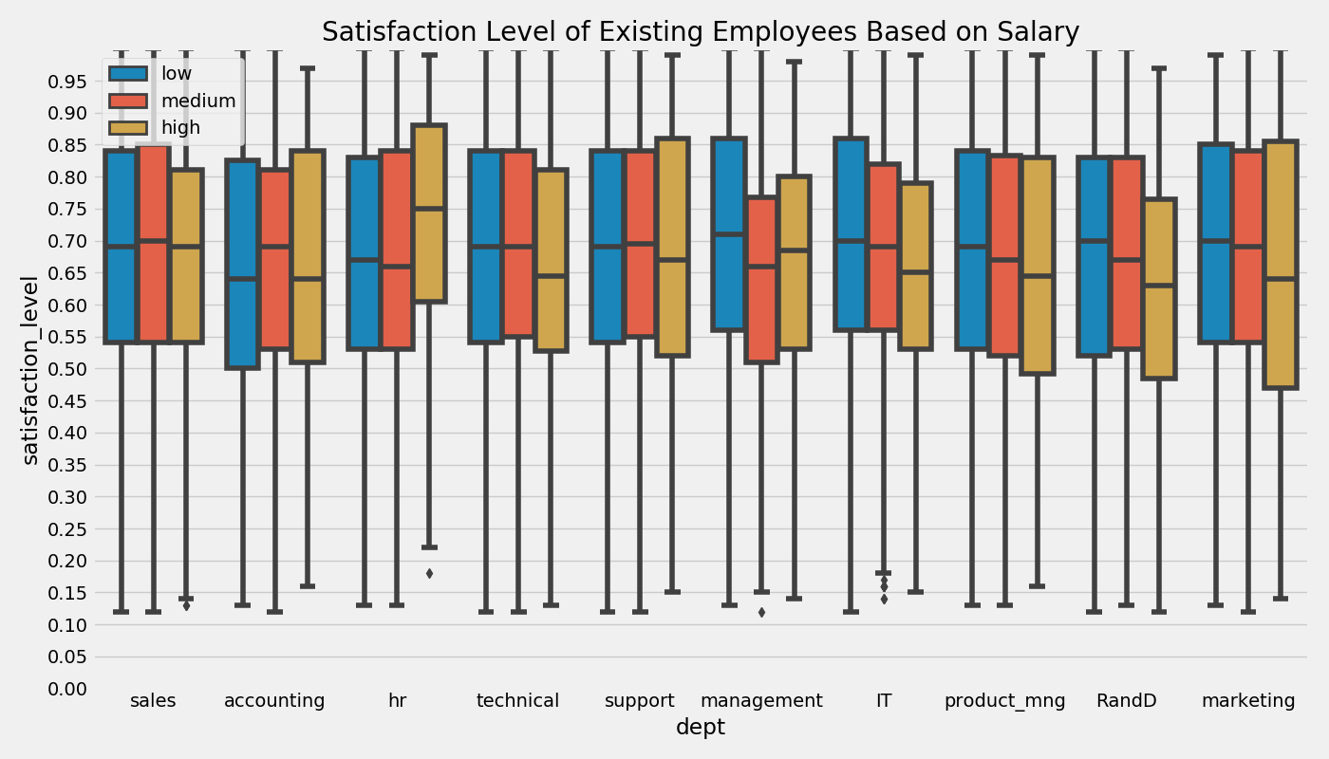
MULTI-VARIANT ANALYSIS
PLOT 3: SATISFACTION LEVELS AND DEPARTMENTS OF EXISTING AND EX-EMPLOYEES WHO LEFT BASED ON SALARY

Slide 9
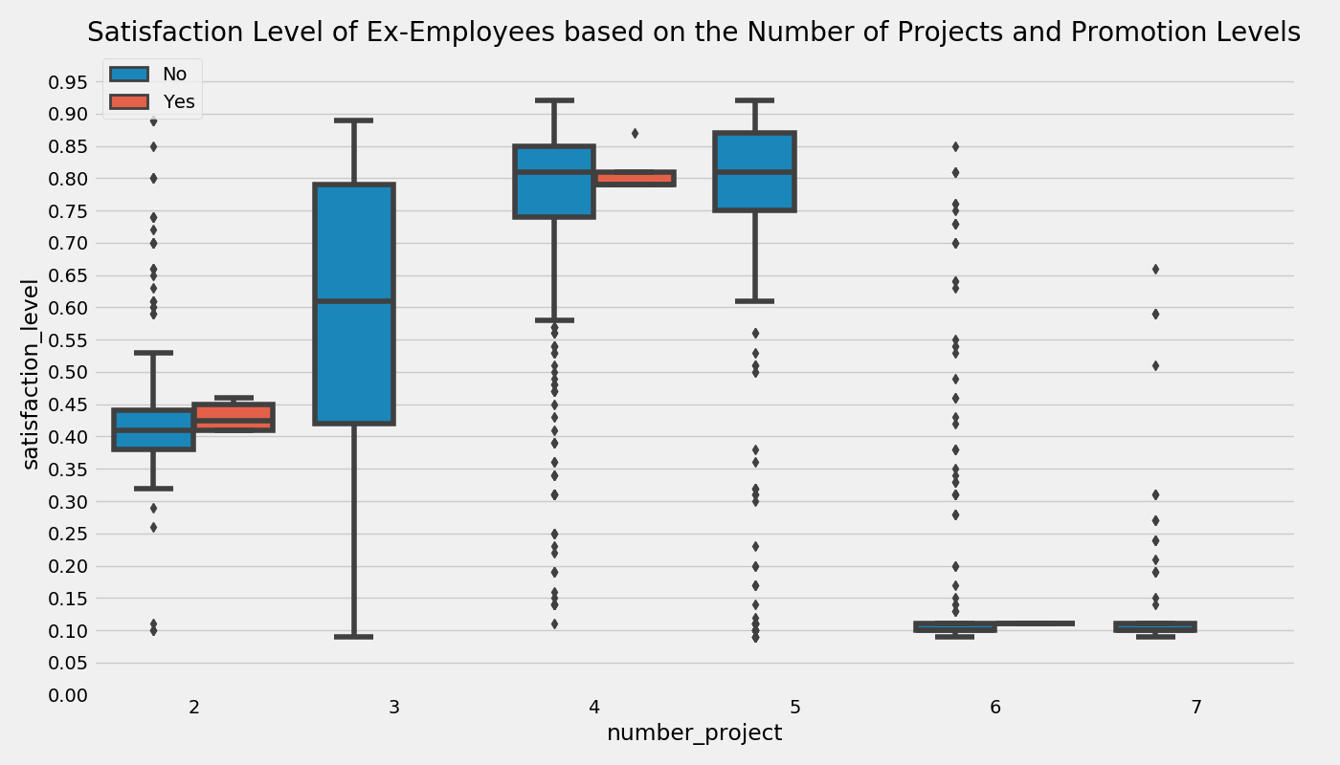
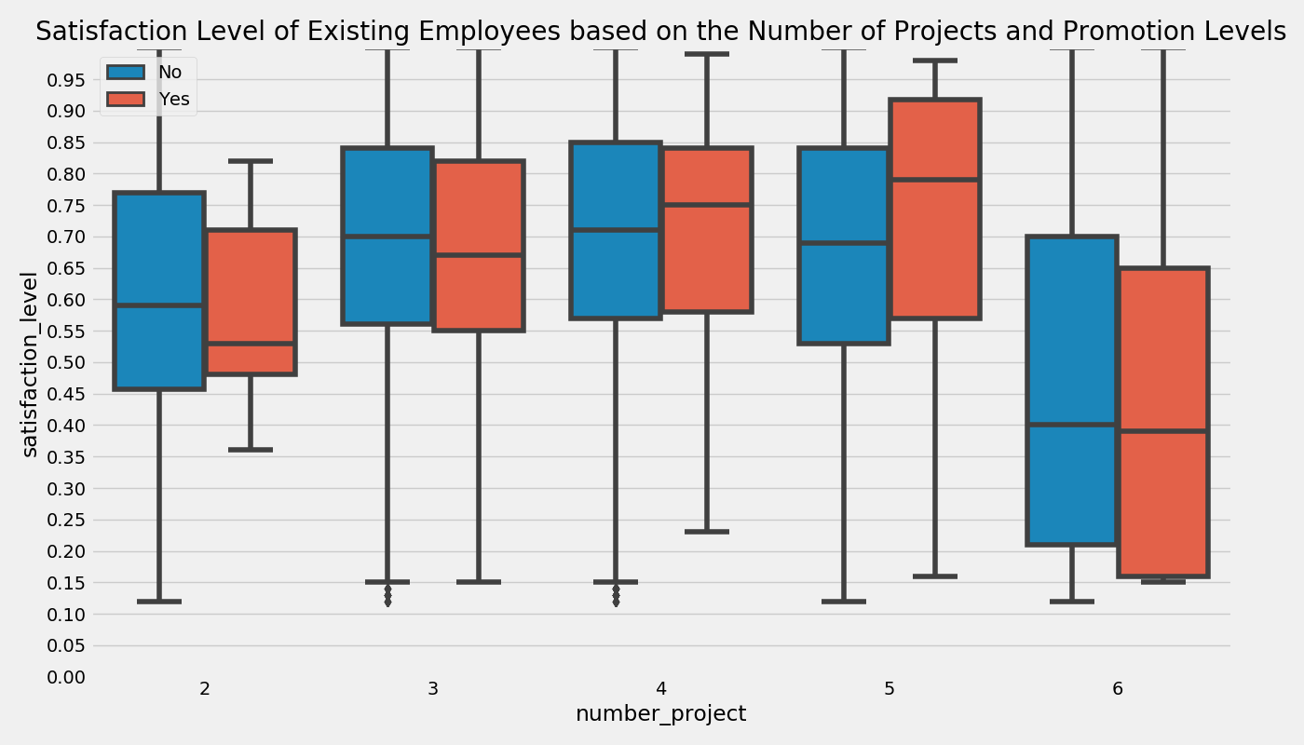
MULTI-VARIANT ANALYSIS
PLOT 4: COMPARISON OF SATISFACTION LEVELS BASED ON NUMBER OF PROJECTS AND PROMOTION LEVEL.

Slide 10
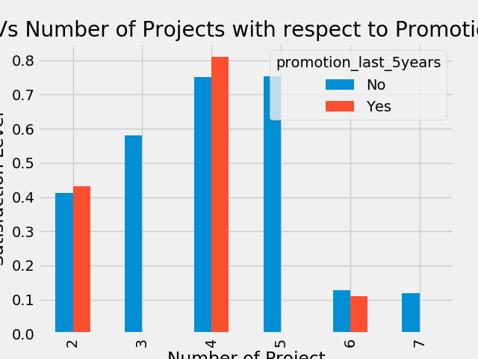
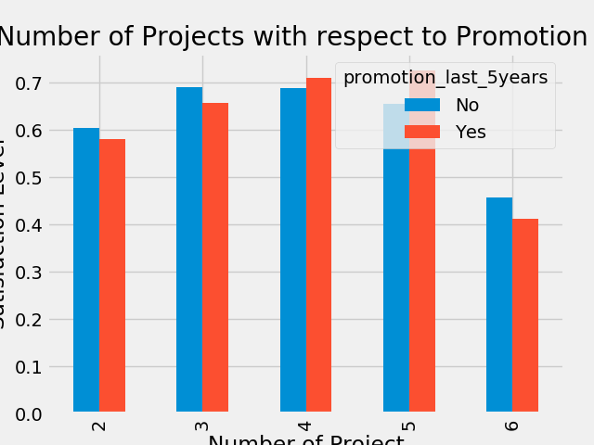
MULTI-VARIANT ANALYSIS
PLOT 5
Satisfaction level(y-axis) of ex-employees based on number of projects(x-axis) and promotion in the last 5 years
Satisfaction level(y-axis) of ex-employees based on number of projects(x-axis) and promotion in the last 5 years

Slide 11
OBSERVATION
From Plot 1 we can identify that most of the employees who left had low salaries. In fact, over 60% of the employees have low to medium salary range.
The employees who left had a satisfaction level between 40%- 45% while the existing employees had a satisfaction above 65% as seen in Plot 2. Therefore, it is right to assume that satisfaction level is a notable factor in determining the employees prone to leave the company.
From plot 5,it is discovered that most of the employees who left have not been promoted in the last 5 years even though they worked on more projects,

Slide 12

CONCLUSION
The prime factor that caused the employee attrition was a low ‘satisfaction level’ contributed to by low to medium salary for more project works and delayed promotions.
Therefore, such an employee is likely to leave the company.

